Slide 1

Heart Disease Predication
Project

Slide 2
Problem Statement
Heart disease increases day by day.
Machines and highly expensive doctors.
Ineffective techniques to find disease.

Slide 3
Our Aim
To make a cost-free and highly accurate machine learning model.
To predict with few attributes and faster efficiency the risk of having heart disease.
Open-source dataset from Kaggle.

Slide 4
Machine Learning algorithm
Classification is a supervised learning technique.
classifying involves grouping a collection of data into various categories
binary classification machine learning algorithms.
Logistic Regression, Decision Tree, Naïve Bayes

Slide 5
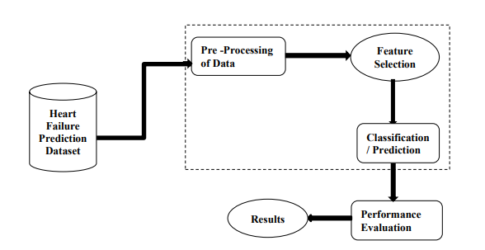
METHODOLOGY

Slide 6
Conclusion
Three algorithms Decision Tree, Naïve Bayes and Logistic regression.
Naive Bayes and Decision Tree in-depth and record the best accuracy results for the dataset under evaluation, which were 85.0% and 94.0%
Naive Bayes has an accuracy of 85%, a precision of 86%, and a recall of 85%
Decision Tree has a 94% accuracy rate, 95% recall rate, and 94% precision rate.

